Slide 1
DEFENSE ROADMAP
Acute Netrin-1 induces a rapid, reversible transcriptional pulse
The deck is organized as a question-to-evidence arc, not as a file-by-file result tour.
5 min
r = -0.991
313
0
main response window
pathway reversal by 15 min
5v0 significant GO BP terms
15v0 significant GO BP terms
Central claim
Netrin-1 does not simply trigger local cytoskeletal signaling; within minutes, it engages a coordinated and transient transcriptional program in cortical neurons.
Acute Netrin-1 RNA-seq analysis
01
Notes:
Start by stating the thesis in one sentence.
Emphasize that the strongest claim is pathway-level and time-resolved: a 5-min pulse that reverses by 15 min.
Tell the committee that the deck will move from design and QC to single-gene evidence, pathway evidence, and a model.

Slide 2
BIOLOGICAL CONTEXT
Netrin-1 is classically fast, local and guidance-related
The open question is whether a minutes-scale transcriptional layer also exists.
Ligand
Receptors
Local response
Known timescale
Unknown layer
This study
>
>
>
>
>
Netrin-1 cue
DCC / UNC5 axis
growth cone and cytoskeleton
seconds to minutes
acute nuclear RNA response
5 and 15 min RNA-seq
- Canonical Netrin-1 biology centers on axon guidance and growth-cone remodeling.
- Most transcriptomic studies resolve hour-to-day programs, not acute 5-15 min changes.
- This creates a testable gap: can a guidance cue rapidly reshape the neuronal transcriptome?
Source: thesis writing pack; literature citations to be added in manuscript
02
Notes:
Frame this as a conceptual gap, not as a claim that local mechanisms are insufficient.
The experiment asks whether a transcriptional component runs in parallel with canonical local signaling.

Slide 3
THESIS QUESTION
Is acute Netrin-1 stimulation transcriptionally visible within minutes?
Three concrete questions define the analysis.
Magnitude
Direction
Duration
Are there detectable genes or pathways after only 5 min?
Which biological programs go up or down?
Does the response persist, or return toward baseline by 15 min?
Working hypothesis: if an acute transcriptional program exists, it should be small at the DEG level but coherent at the pathway level.
Acute Netrin-1 RNA-seq analysis
03
Notes:
Set up why GSEA matters before showing the data.
A five-minute RNA-seq study should not be expected to produce hundreds of large-effect DEGs.

Slide 4
EXPERIMENTAL DESIGN
A minimal acute time course tests the onset and reversal of transcriptional change
Nine RNA-seq samples: three conditions with three biological replicates each.
E18 rat
Vehicle
Netrin-1
Netrin-1
RNA-seq
DESeq2
>
>
>
>
>
primary cortical culture
PBS, 5 min
5 min
15 min
DRAGEN Salmon
replicate-adjusted
- Design: Vehicle, 5 min Netrin-1, and 15 min Netrin-1.
- n = 3 biological replicates per condition; each replicate is an independent well.
- Important limitation: the same Vehicle 5-min control anchors both Netrin timepoints.
Acute Netrin-1 RNA-seq analysis
04
Notes:
Be transparent about the design limitation early.
This will make the later emphasis on 5v0 and 15v5 easier to defend.

Slide 5
ANALYSIS WORKFLOW
Differential expression used raw counts; batch correction was reserved for visualization
This separation is important for statistical interpretability.
Quantify
Import
Filter
Model
Contrasts
GSEA
>
>
>
>
>
gene-level Salmon output
tximport with length offset
32623 to 14161 genes
~ replicate + timepoint
5v0, 15v0, 15v5
GO BP and KEGG
DE tests
Visualizations
Raw counts with replicate in the model
Batch-corrected only where explicitly visualized
Methods: DESeq2, limma, clusterProfiler, org.Rn.eg.db
05
Notes:
Stress that replicate is modeled, not ignored.
Explain relaxed and strict thresholds if asked: padj < 0.05, strict adds absolute log2FC > 0.585.

Slide 6
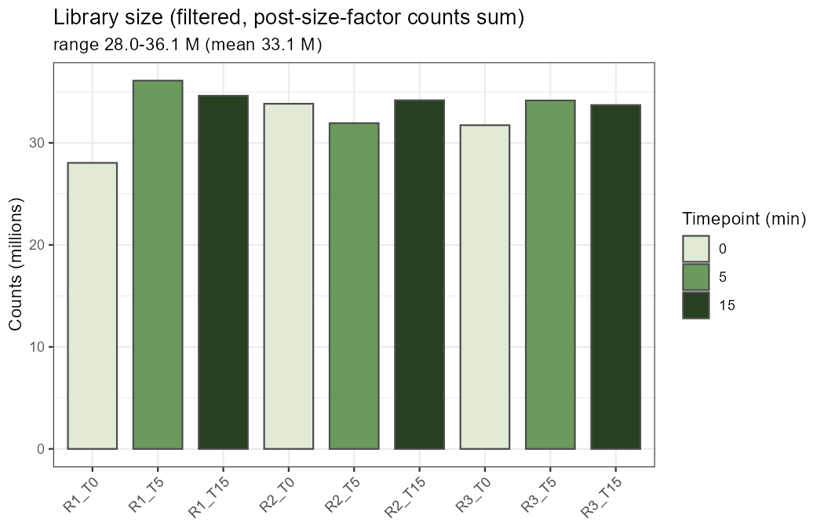
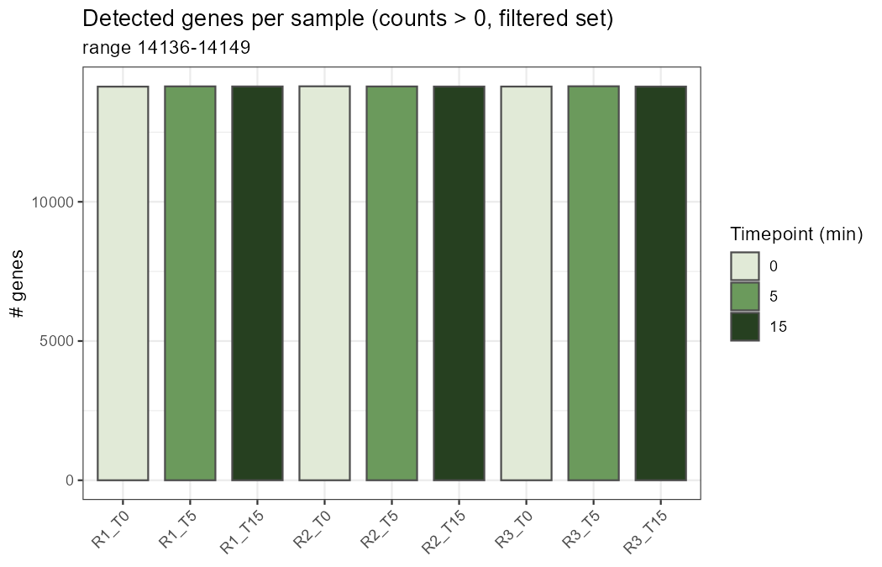
SEQUENCING QC
Library size and detected genes are broadly comparable across samples
No single sample drives the analysis by obvious sequencing-depth failure.
Source: results/01_QC
06
Notes:
Keep this slide short: the purpose is to reassure the committee before the biological slides.
Mention that detailed QC files remain available in the results folder.

Slide 7
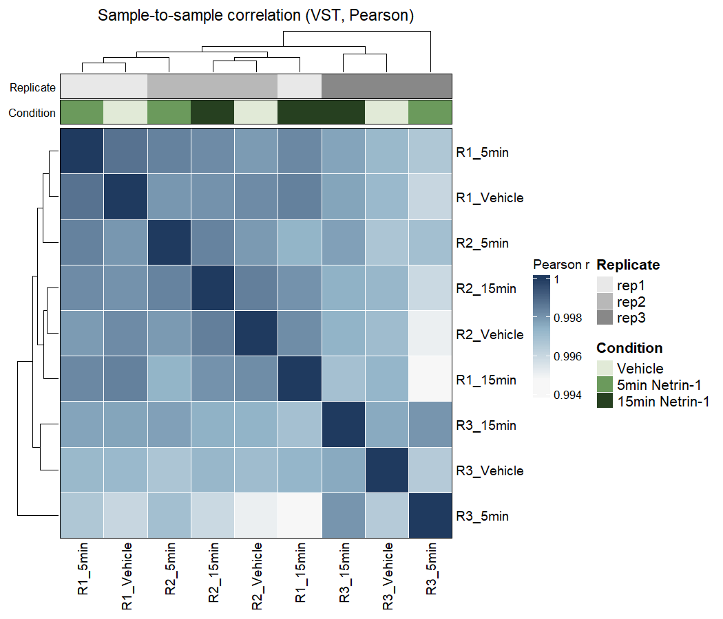
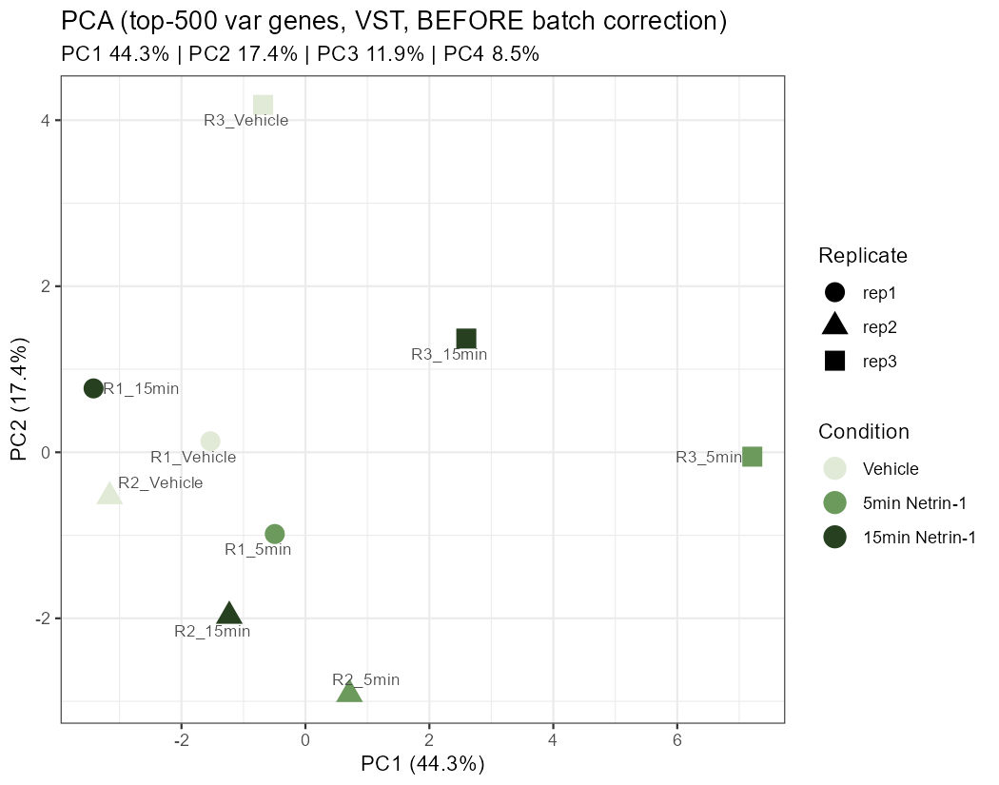
REPLICATE STRUCTURE
Sample correlation and PCA expose replicate effects that the model explicitly accounts for
This is why replicate was included as a model term.
Source: results/01_QC
07
Notes:
Acknowledge that replicate explains a large part of top-level variance.
Then immediately connect this to the model: replicate was included in the design, so DE inference is adjusted.

Slide 8
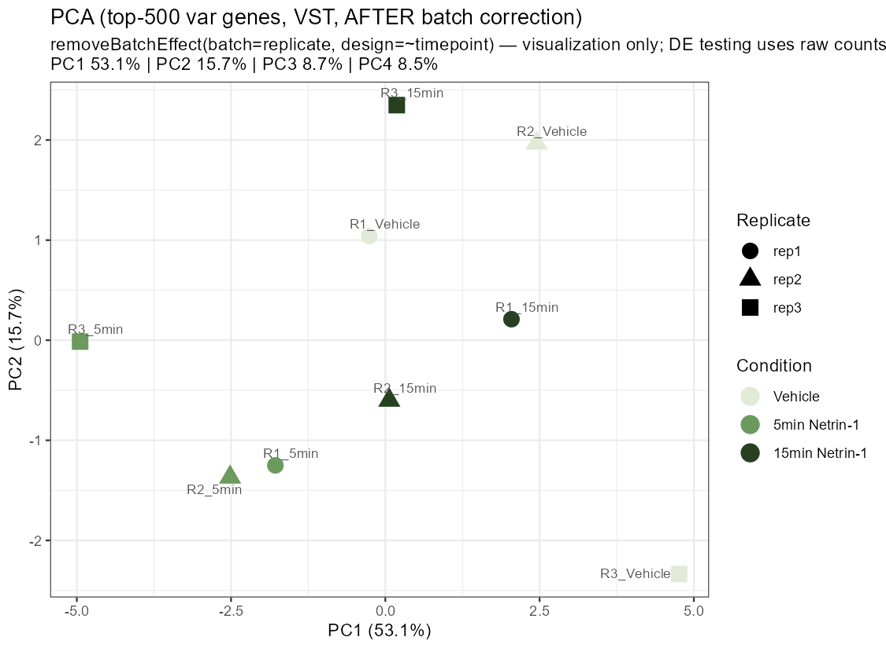
VISUALIZATION AFTER CORRECTION
Removing replicate effects for PCA reveals the expected timepoint axis
Batch correction is used here only to make the time structure visible.
Interpretation
- Timepoint becomes the dominant visible structure.
- This supports, but does not replace, the replicate-adjusted DE model.
- The key biological comparison remains 5v0 and 15v5.
Source: results/01_QC
08
Notes:
Use this slide to prevent a common concern: the analysis is not hiding batch effects.
Clarify the distinction between visualization correction and statistical testing.

Slide 9
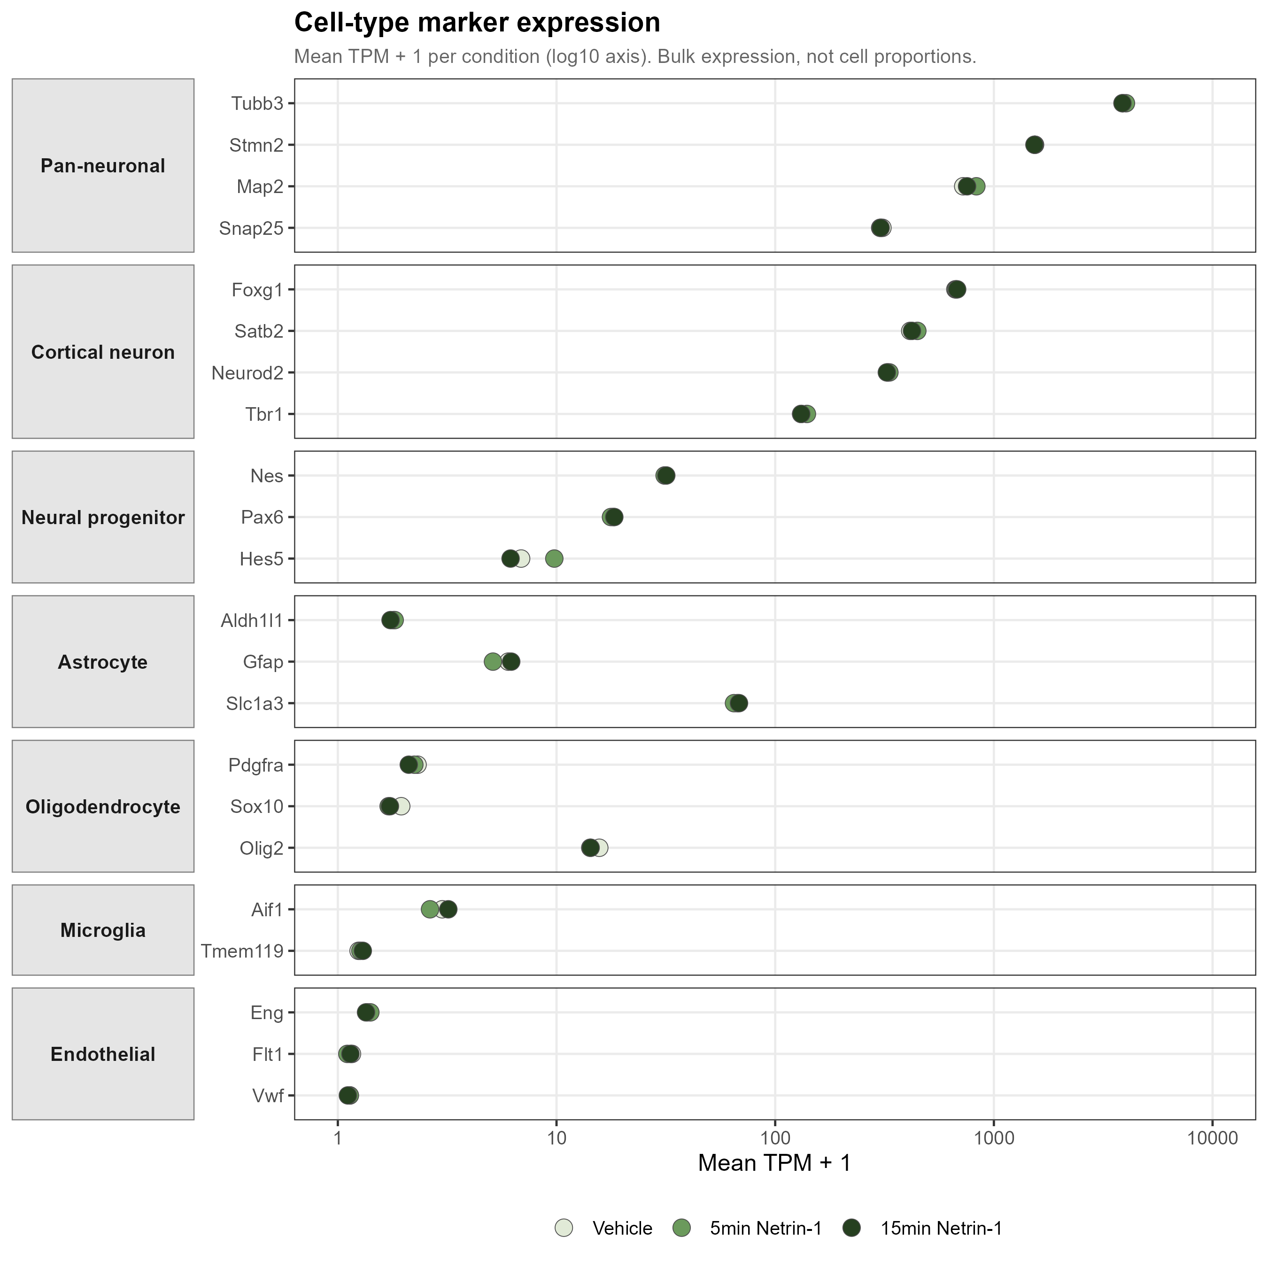
CULTURE COMPOSITION
Marker expression supports neuron-dominant, composition-stable cultures
Cell-type markers do not suggest that the acute signal is driven by a change in composition.
Key readout
Pan-neuronal markers are high, while glial/endothelial markers are orders of magnitude lower and stable across conditions.
Source: results/02_composition
09
Notes:
Point to Tubb3, Stmn2 and Map2 as high neuronal markers.
The main purpose is to argue that downstream changes are transcriptional, not culture-composition shifts.

Slide 10
ANALYSIS STRATEGY
Minutes-scale transcriptional effects are expected to be small but coordinated
Therefore single-gene and pathway-level evidence are interpreted together.
32
5
313
14
5v0 relaxed DEGs
5v0 strict DEGs
5v0 GO BP terms
5v0 KEGG pathways
Interpretation rule
A modest DEG count is not a weak result when pathway ranks show coherent biological directionality across thousands of genes.
Values verified from DEG and GSEA CSV files
10
Notes:
This slide prevents the committee from over-focusing on the small number of strict DEGs.
It also sets up why the GSEA slides are central evidence rather than secondary decoration.

Slide 11
TIMING OF RESPONSE
The strongest transcriptional change occurs at 5 min, not at 15 min versus Vehicle
This supports an acute pulse rather than a persistent endpoint shift.
5v0
15v0
15v5
32 relaxed DEGs; 5 strict DEGs
1 relaxed/strict DEG; 0 GO BP terms
6 relaxed DEGs; 295 GO BP terms
The informative temporal contrast is 15v5: it asks whether the 5-min state is actively reversed by 15 min.
Values verified from DEG and GSEA CSV files
11
Notes:
Make the contrast logic explicit.
15v0 alone is limited by the shared control design; 15v5 closes the temporal loop.

Slide 12
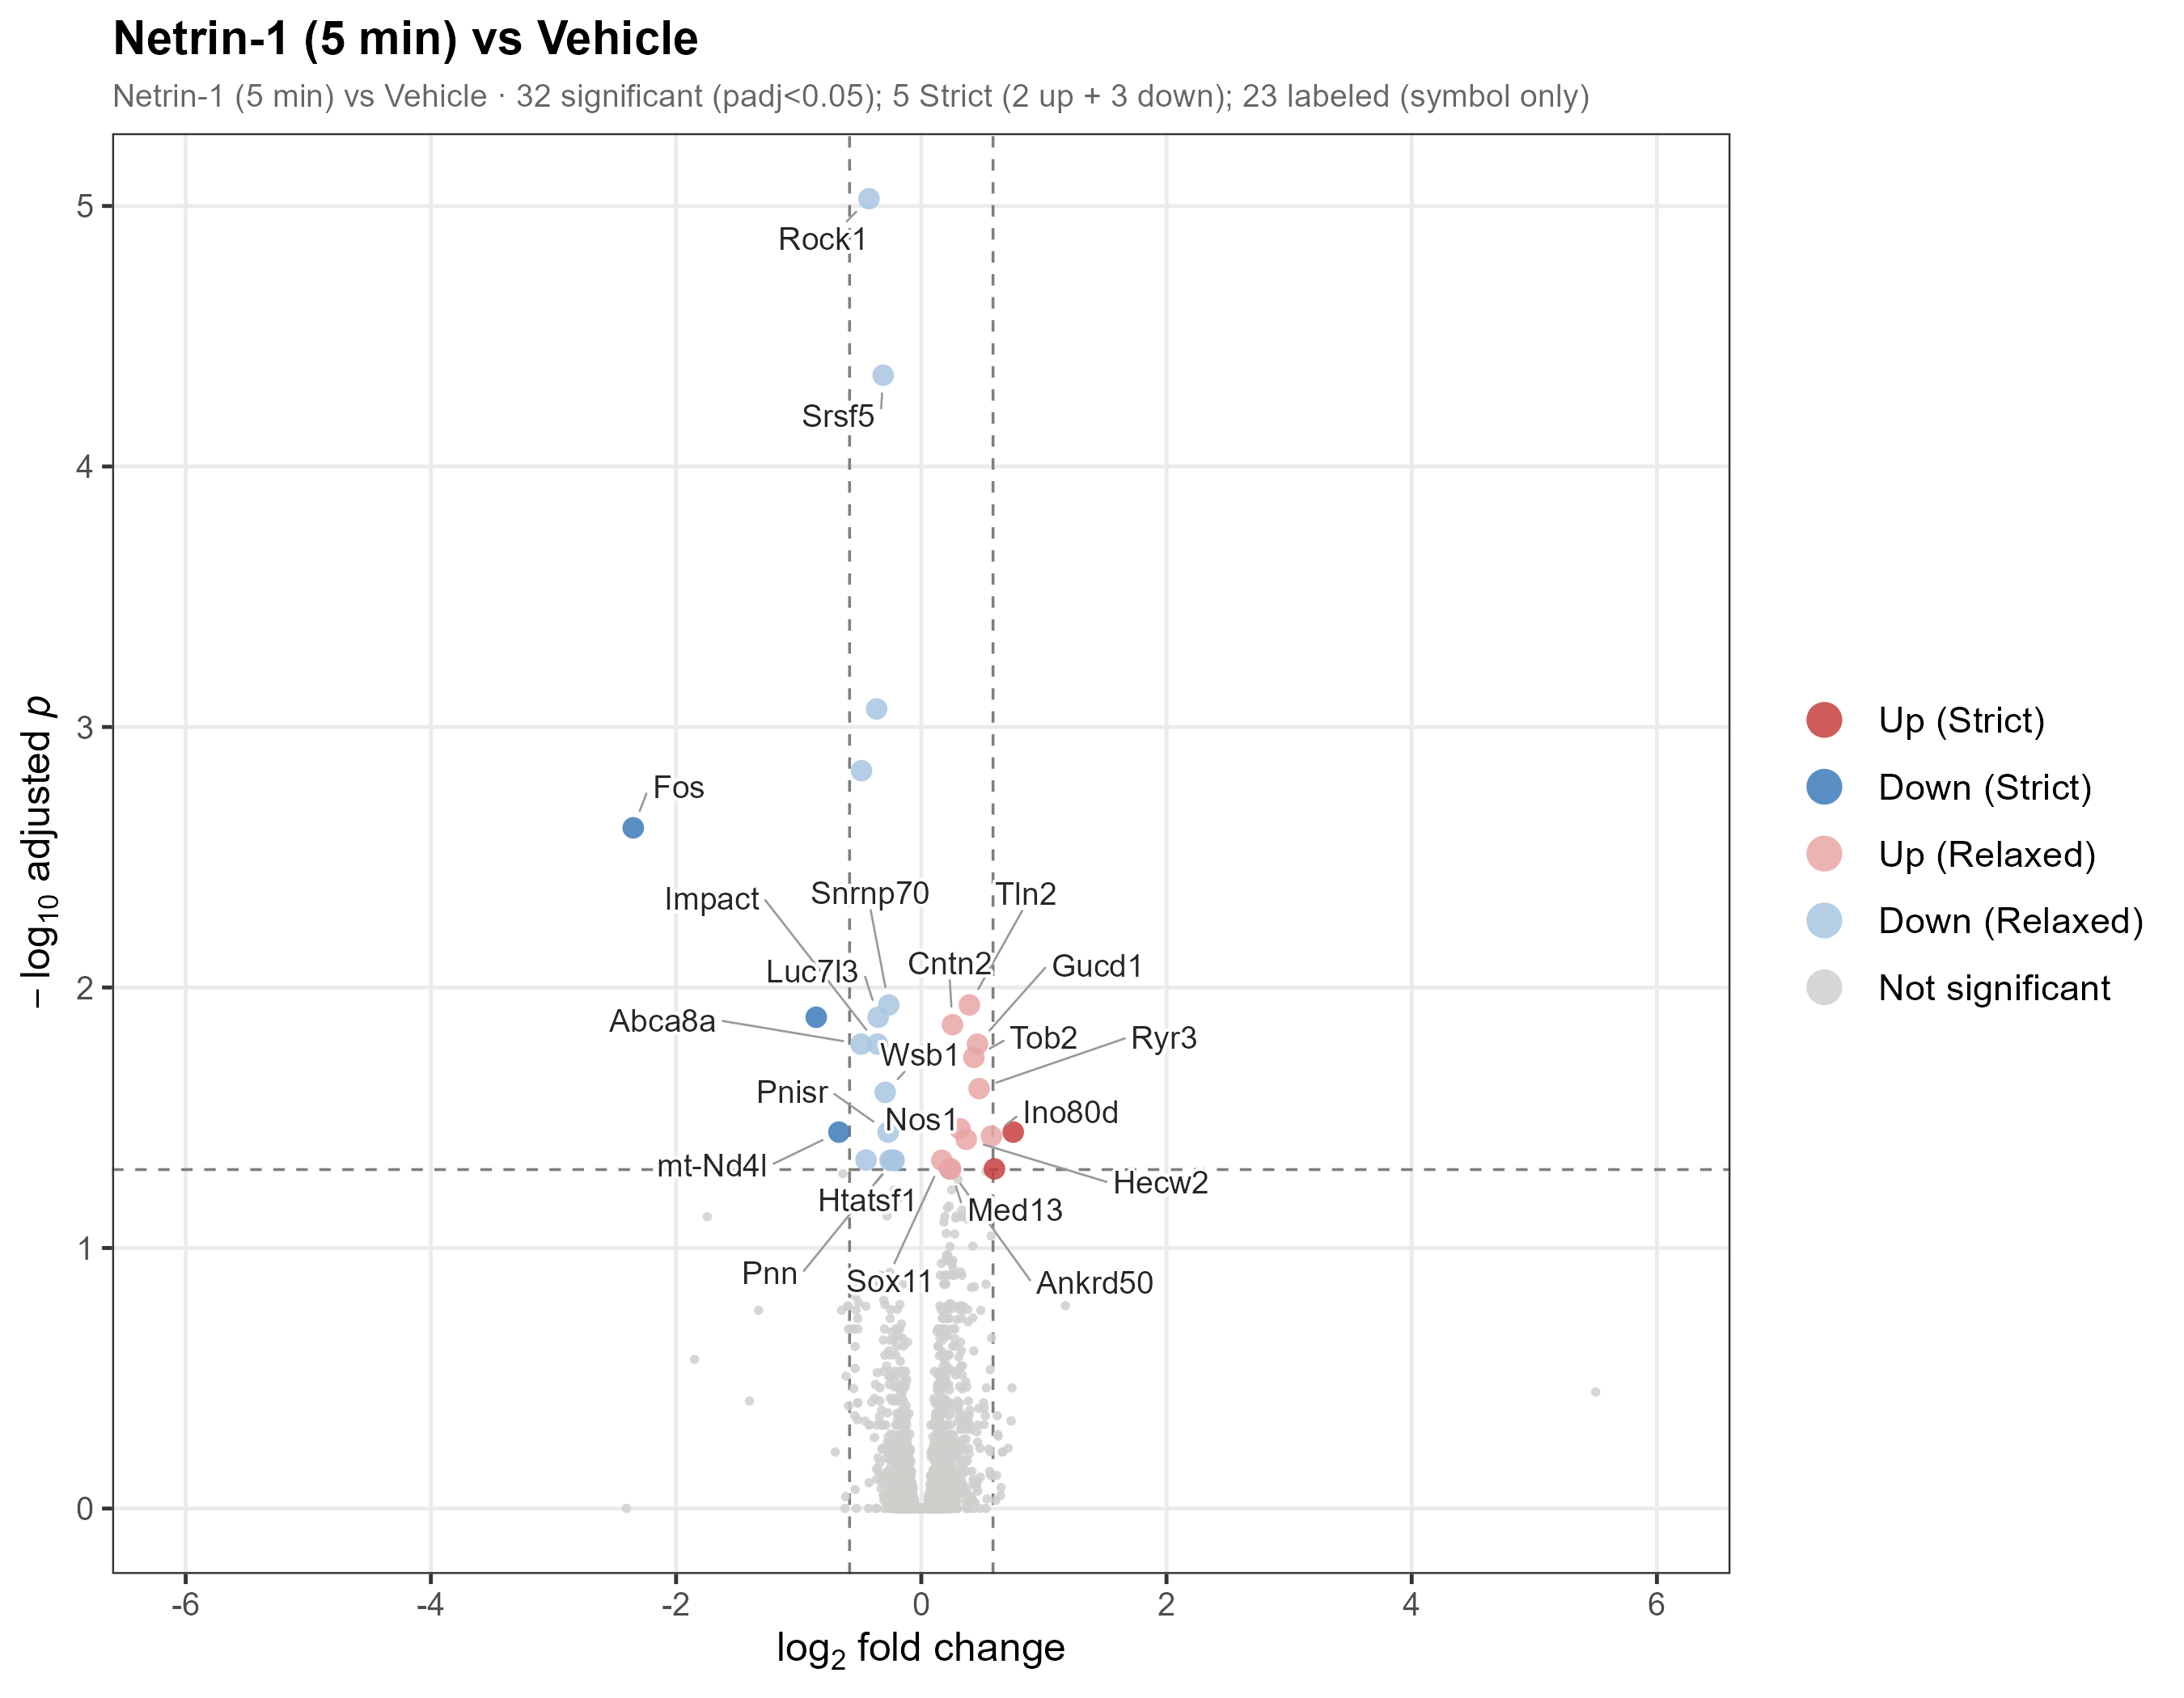
5-MIN DEG EVIDENCE
A small DEG set captures interpretable acute response genes
The volcano plot identifies the strongest single-gene anchors for the pathway story.
Highlighted genes
- Fos: acute IEG suppression
- Rock1: cytoskeletal signaling
- Srsf5/Snrnp70: RNA processing
- Cntn2: axon guidance
- Nos1/Ryr3: NO-calcium module
Source: results/03_DEG/04_volcano_5v0_v6.png
12
Notes:
The key is not the number of points; it is that the genes are biologically coherent.
Use Fos and Rock1 as concrete anchors before moving to GSEA.

Slide 13
REPRESENTATIVE GENES
The 5-min DEGs map to a bidirectional biological program
Several modest log2FC values are highly significant because baseline expression is robust.
Gene | log2FC | padj | Module
Fos | -2.35 | 2.4e-3 | IEG suppression
Rock1 | -0.43 | 9.4e-6 | cytoskeleton
Srsf5 | -0.31 | 4.5e-5 | splicing
Cntn2 | +0.25 | 1.4e-2 | axon guidance
Nos1 | +0.32 | 3.5e-2 | NO signaling
Ryr3 | +0.47 | 2.4e-2 | calcium release
Pattern
Guidance and signaling genes rise, while immediate-early and RNA-processing genes fall.
Source: results/03_DEG/DEG_5v0_ALL.csv
13
Notes:
This table is designed for oral defense: you can point to one or two genes rather than reading every row.
Mention Npas4 verbally as LRT-supported if the committee asks about IEGs.

Slide 14
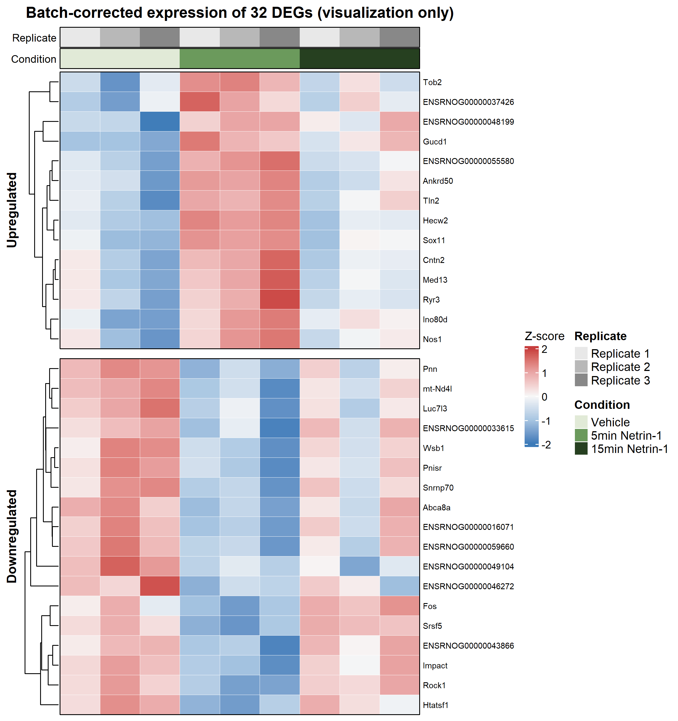
DEG HEATMAP
The 5-min DEG set forms a coherent sample-level pattern
The heatmap checks whether DEG behavior is distributed across samples rather than confined to one point.
Readout
The selected DEGs separate the 5-min response while remaining consistent with the replicate-adjusted model.
Source: results/03_DEG/06_DEG_heatmap_5v0_v4.png
14
Notes:
Use this as a bridge from individual genes to temporal behavior.
Avoid overclaiming clustering; the main claim is coherence, not perfect classification.

Slide 15
LRT ANALYSIS
The LRT asks whether genes change anywhere across the acute time course
For trajectory visualization, row-scaled VST expression is the most defensible y-axis.
Statistical test
Visualization y-axis
Why not log2FC?
Full model:
~ replicate + timepoint
Reduced model:
~ replicate
Z-score of VST-normalized expression
Also label as:
row-scaled VST expression
LRT is an overall time-effect test, not a single contrast. Z-score preserves the temporal pattern across Vehicle, 5 min and 15 min.
19
LRT-significant time-varying genes
Source: DESeq2 LRT; trajectory plotted as VST z-score
15
Notes:
Use this slide to explain what the LRT tests before showing the trajectory.
The y-axis choice matters: row-scaled VST expression shows shape, whereas log2FC would impose a pairwise interpretation.

Slide 16
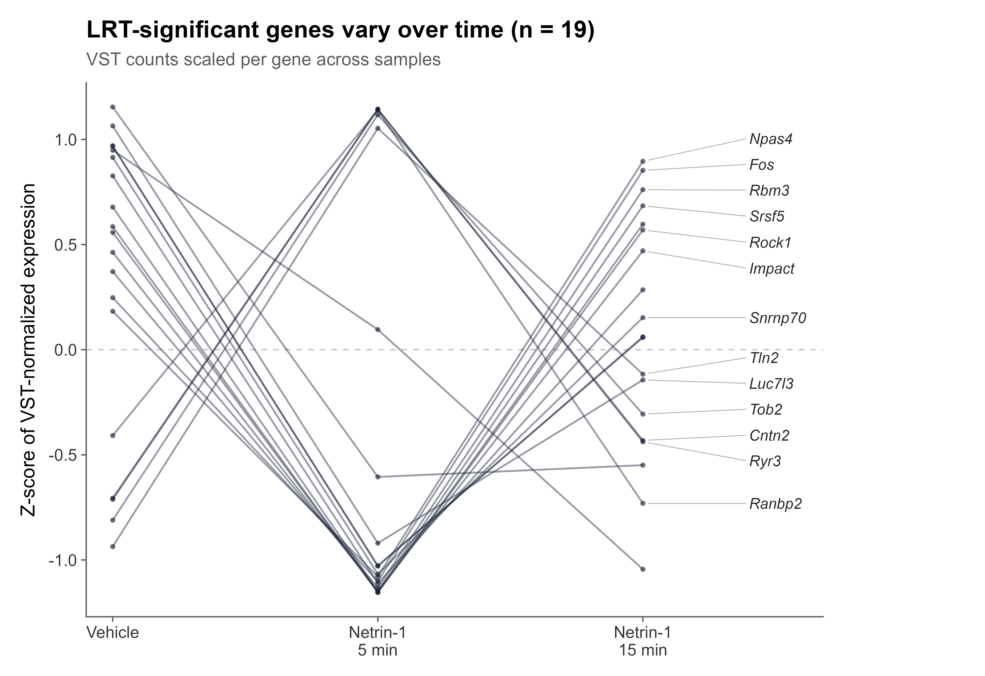
LRT TRAJECTORIES
Nineteen LRT genes show coordinated time-dependent expression patterns
The plot emphasizes temporal shape rather than absolute gene abundance.
Readout
- Rows are genes; values are scaled per gene.
- Patterns converge on a 5-min pulse and recovery/rebound.
- This supports temporal coordination beyond pairwise DEGs.
Source: results/objects/LRT_19_trajectory_VSTzscore_v1.png
16
Notes:
Point out that this figure uses Z-score of VST-normalized expression.
Describe the plot as time-dependent genes identified by LRT, not as a Wald contrast.

Slide 17
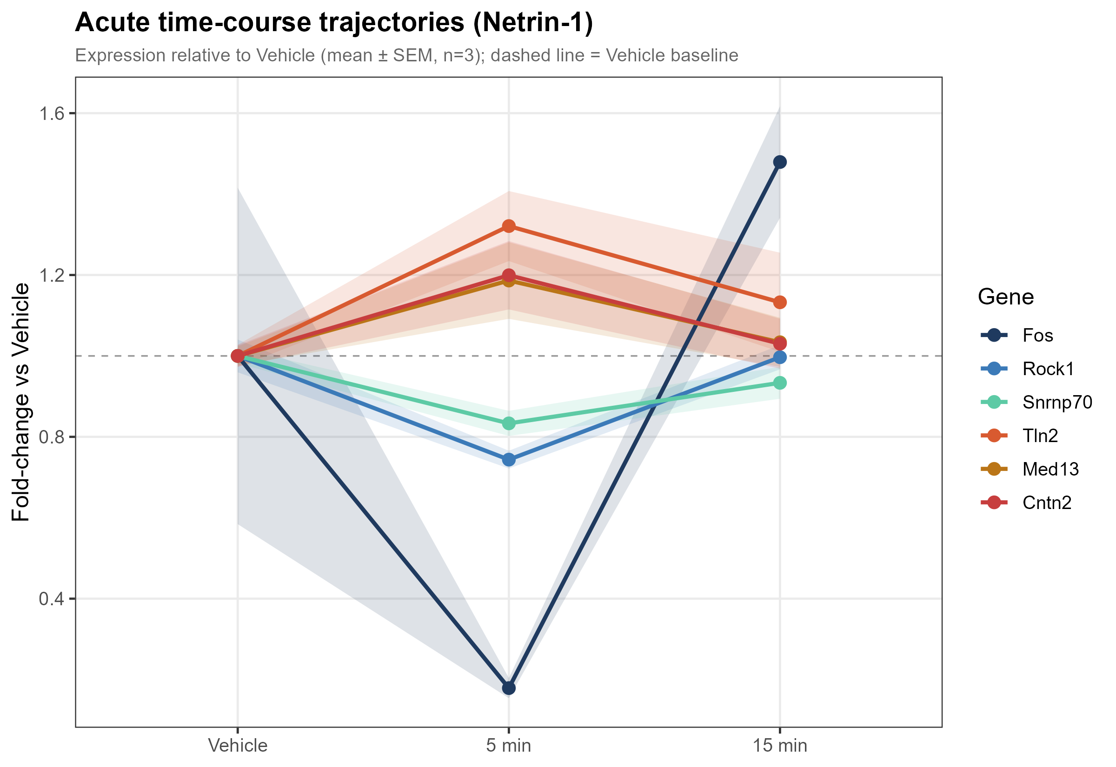
TEMPORAL DYNAMICS
Representative genes show a 5-min deviation followed by partial or full return
This supports pulse-like behavior at the gene level.
Important nuance
- Most LRT-significant genes behave like a pulse.
- Fos rebounds above Vehicle at 15 min.
- Vehicle variation for Fos is visible and should be stated honestly.
Source: results/03_DEG/05_trajectory_6genes.png
17
Notes:
This is a good place to show scientific caution.
The pathway-level reversal is cleaner than every individual gene trajectory.

Slide 18
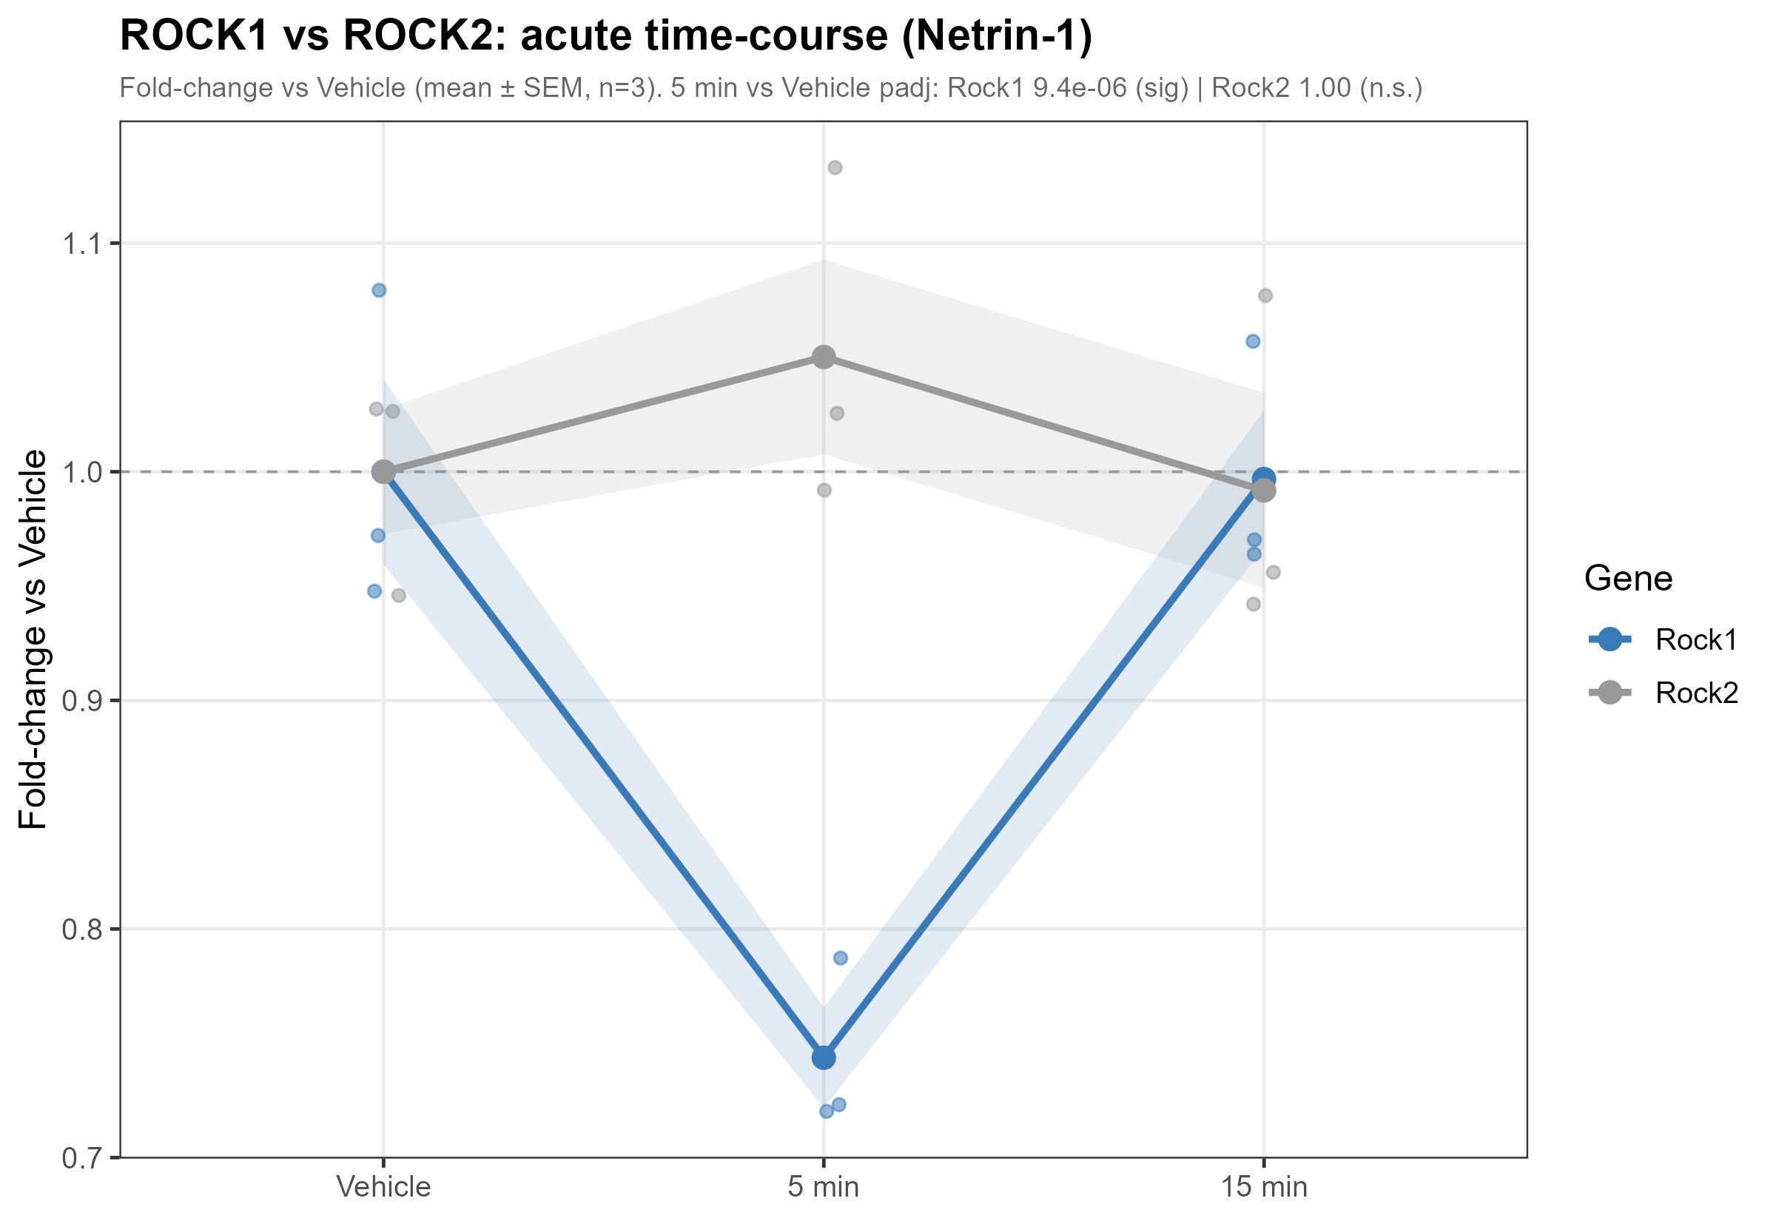
ROCK SPECIFICITY
Rock1 decreases acutely, while Rock2 remains statistically unchanged
This suggests selective regulation within a canonical cytoskeletal signaling family.
5v0 contrast
Rock1: log2FC -0.43, padj 9.4e-6
Rock2: log2FC +0.07, padj 0.999
Source: results/03_DEG/05b_rock1_vs_rock2_trajectory.png
18
Notes:
This slide is useful for mechanism discussion because ROCK is close to canonical guidance signaling.
Do not overstate causality: the RNA-seq shows selective transcriptional response, not protein activity.

Slide 19
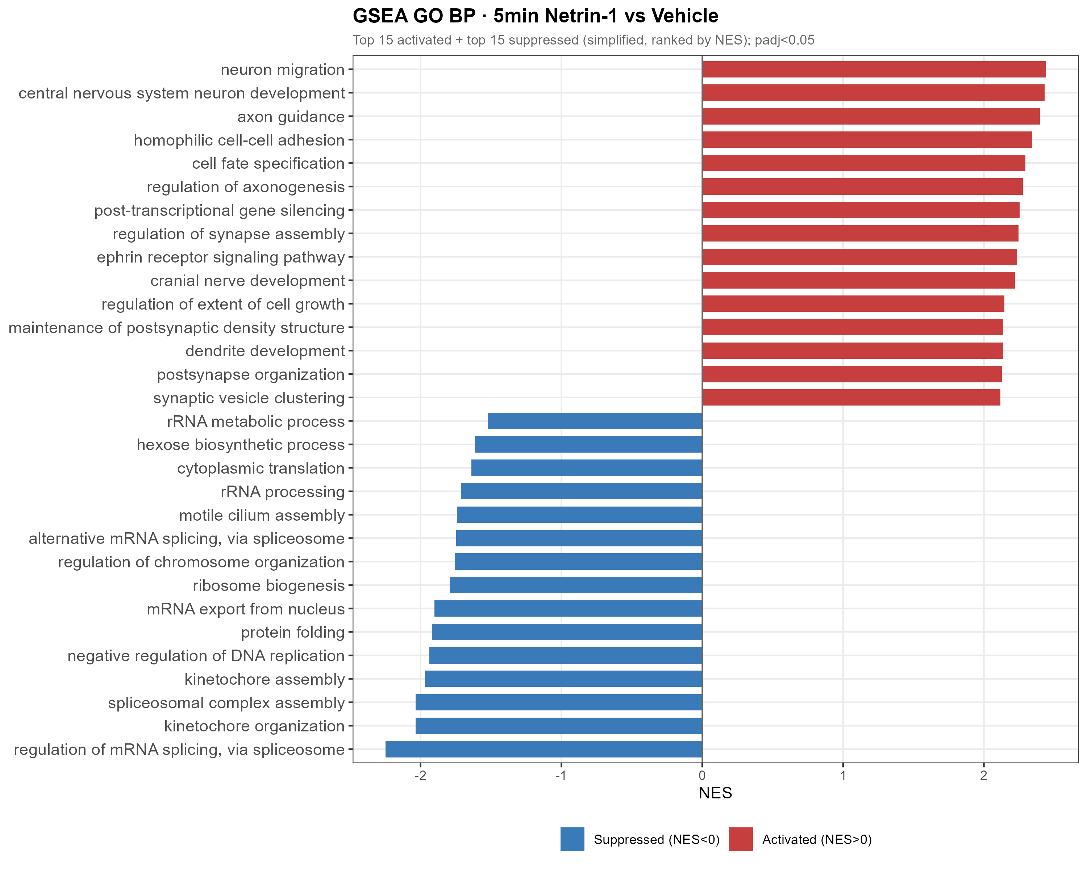
GO BP AT 5 MIN
Netrin-1 activates neuron projection and axon guidance programs within 5 min
The strongest evidence is coordinated ranking across biological processes.
313
significant GO BP terms
285 up
positive NES terms
Source: results/04_GSEA/GSEA_GO_BP_5v0.csv
19
Notes:
Point to central nervous system neuron differentiation, neuron migration, neuron projection guidance, and axon guidance.
This is one of the main result slides.

Slide 20
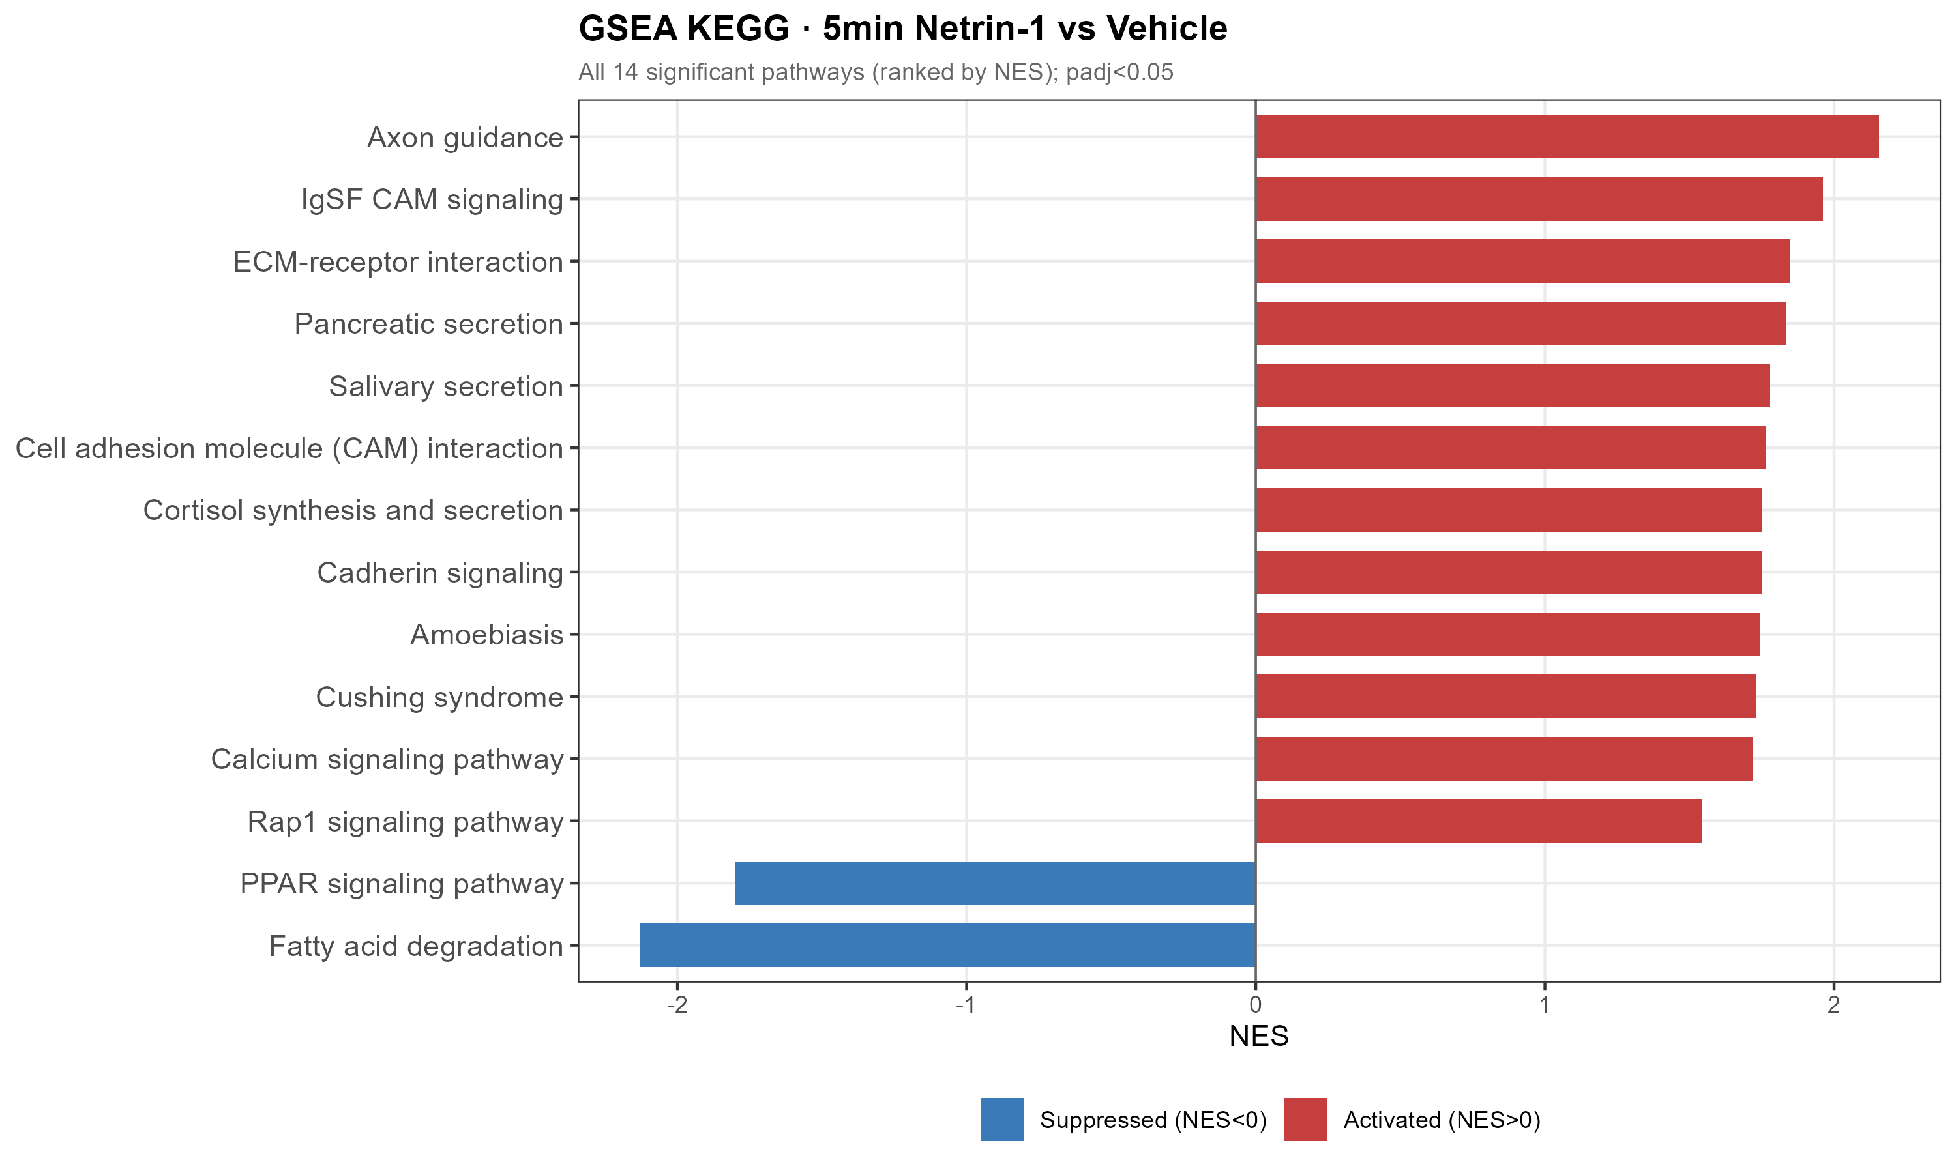
KEGG AT 5 MIN
Axon guidance is the top KEGG pathway in the acute response
The pathway result aligns directly with Netrin-1 biology.
Top KEGG signal
Axon guidance
NES 2.16
BH-adjusted p = 4.1e-7
Source: results/04_GSEA/GSEA_KEGG_5v0.csv
20
Notes:
This slide connects the transcriptomic result back to the ligand's known function.
Mention that calcium and adhesion-related pathways also appear.

Slide 21
PROGRAM ARCHITECTURE
The 5-min response is bidirectional, not a generic activation signature
Guidance-related pathways rise while RNA processing and biosynthetic modules fall.
Up at 5 min
Down at 5 min
- Neuron projection guidance
- Axon guidance
- Synapse assembly
- Cell adhesion / IgSF CAM
- NO-calcium signaling
- RNA processing
- mRNA splicing
- Ribosome biogenesis
- Translation-related programs
- Fatty-acid degradation signature
Source: GSEA GO BP and KEGG 5v0 results
21
Notes:
This is a synthesis slide. It turns the gene and pathway lists into one interpretable program.
Emphasize that the result is coordinated and bidirectional.

Slide 22
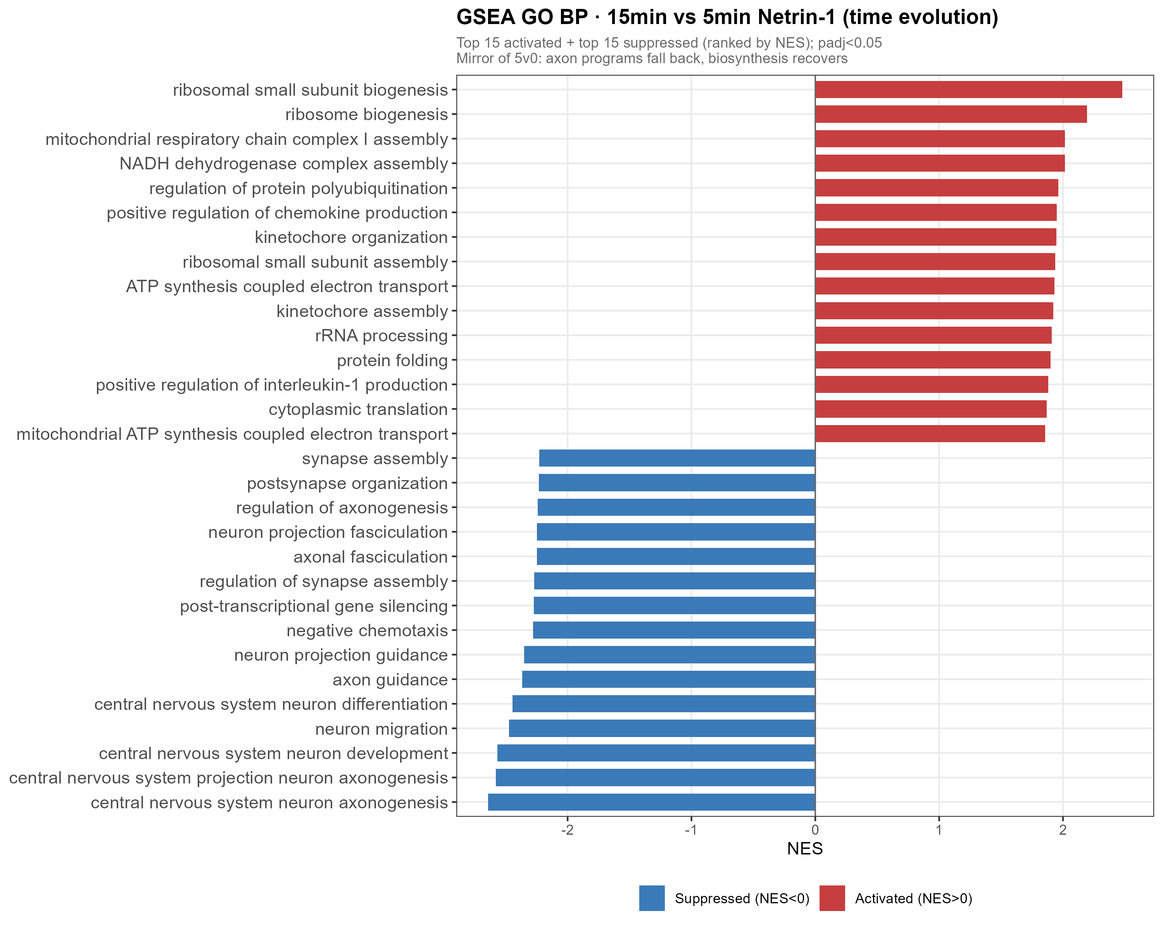
15V5 REVERSAL
By 15 min, the 5-min GO BP program is directionally flipped
The temporal contrast shows active reversal from the acute state.
295
significant GO BP terms
264
negative NES terms
Source: results/04_GSEA/GSEA_GO_BP_15v5.csv
22
Notes:
The important point is not that nothing happens by 15 min; rather, 15v5 shows reversal relative to the 5-min state.
This is central to the transient pulse interpretation.

Slide 23
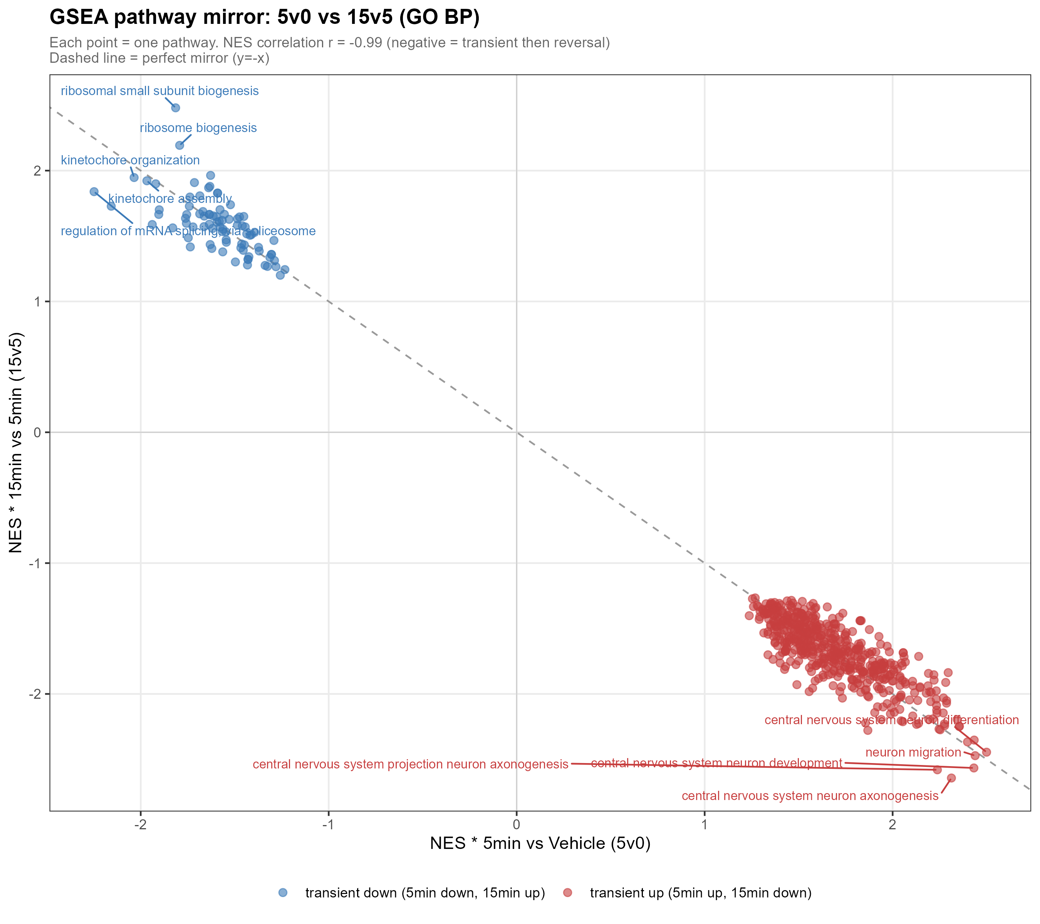
QUANTITATIVE REVERSAL
Shared pathways show near-perfect mirror symmetry between 5v0 and 15v5
This is the strongest quantitative evidence for a transient program.
Mirror statistic
603 shared pathways
NES correlation
r = -0.991
Source: results/04_GSEA/13_GSEA_mirror_scatter_5v0_vs_15v5.png
23
Notes:
Pause on this slide. It is the headline result.
Explain that the same pathways that rise at 5 min tend to fall in 15v5, and vice versa.

Slide 24
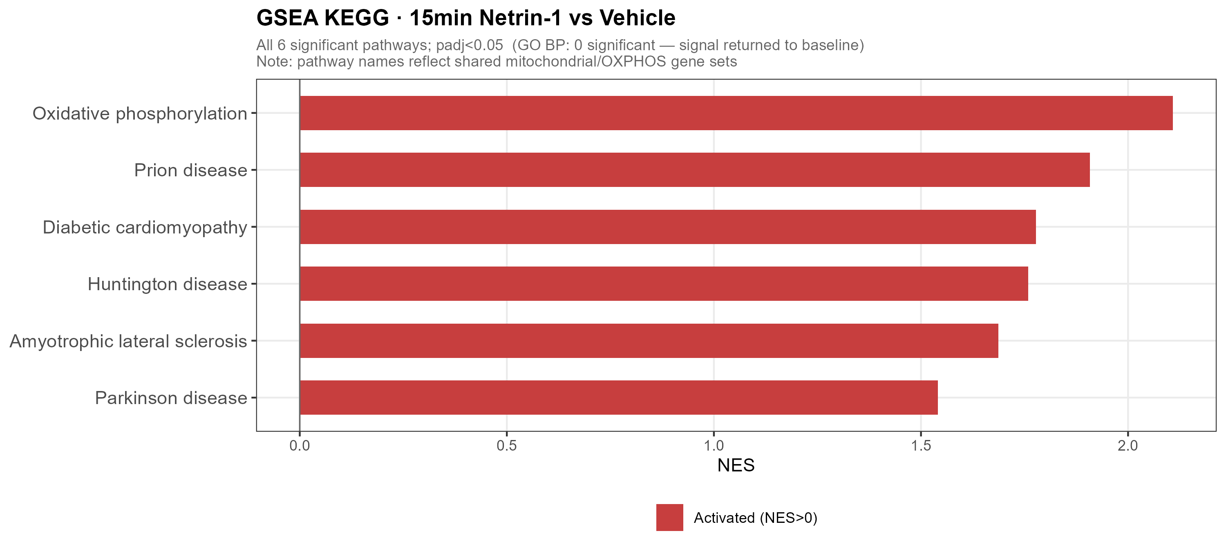
RETURN TOWARD BASELINE
15v0 has no significant GO BP terms, with a mild mitochondrial KEGG signal
This supports pathway-level return while preserving an honest caveat.
Interpret carefully
- GO BP: 0 significant terms
- KEGG: 6 significant terms
- OXPHOS leads the KEGG signal
- Disease labels reflect shared mitochondrial genes, not disease biology
Source: results/04_GSEA/GSEA_GO_BP_15v0.csv and GSEA_KEGG_15v0.csv
24
Notes:
This slide is intentionally nuanced.
Say that the transcriptional guidance program largely returns, while a late mitochondrial/OXPHOS signal remains detectable.

Slide 25
INTEGRATED EVIDENCE
Multiple result layers converge on the same transient program
This table is the defense-ready summary of the core evidence chain.
Module | 5 min | By 15 min | Evidence
Axon guidance / projection | up | falls back | GO BP, KEGG, Cntn2
RNA processing / splicing | down | recovers | Srsf5, Snrnp70, GO BP
IEG response | down | rebound/return | Fos, Npas4/LRT
ROCK / cytoskeleton | Rock1 down | Rock2 stable | DEG + trajectory
NO-calcium / adhesion | up | falls back | Nos1, Ryr3, Tln2
Mitochondria / OXPHOS | minor | late rise | 15v0/15v5 KEGG
Source: Phase6 summary table and verified CSV outputs
25
Notes:
This slide is useful if the committee asks you to summarize all results in one view.
The table intentionally combines genes, trajectories and GSEA rather than separating them.

Slide 26
PROPOSED MODEL
Netrin-1 launches a short-lived transcriptional reallocation program
The model integrates guidance activation with transient suppression of general RNA-processing machinery.
5-min transcriptional pulse
Netrin-1
>
>
15-min reversal
acute cue
guidance / projection up
RNA processing / ribosome down
IEG suppression
GO BP returns; 15v5 mirrors 5v0
Mechanistic interpretation: acute guidance cues may transiently bias nuclear programs toward remodeling and away from broad biosynthetic processing, then rapidly reset.
Model synthesized from DEG, trajectory and GSEA results
26
Notes:
Use this as the conceptual payoff of the deck.
Be clear that this is a proposed model, not proven causality.

Slide 27
SCIENTIFIC SIGNIFICANCE
The novelty is minutes-scale coordination, not simply another DEG list
The data connect a classic axon guidance cue to a fast transcriptome-wide response.
Acute transcription
Bidirectional program
Shows that a guidance cue can be transcriptomically visible within 5 min.
Guidance-related pathways rise while RNA processing and ribosome modules fall.
Quantified reversibility
Mechanistic anchors
The response reverses with r = -0.991 across shared GSEA pathways.
Fos/Npas4 suppression and Rock1 specificity provide hypotheses for follow-up.
Acute Netrin-1 RNA-seq analysis
27
Notes:
This is a discussion slide.
Frame novelty conservatively: the dataset suggests a fast transcriptional layer that merits mechanistic validation.

Slide 28
LIMITATIONS
The strongest conclusions are pathway-level and temporal, with clear design boundaries
Being explicit here makes the defense more credible.
- n = 3 per condition: adequate for a focused RNA-seq pilot, but small for subtle single-gene effects.
- No independent PBS-15 min control: 15v0 is useful but should be interpreted with this design caveat.
- Only three timepoints: pulse shape is inferred from 0/5/15 min rather than dense time-course modeling.
- Bulk RNA-seq: marker analysis supports composition stability, but cell-type-specific responses remain unresolved.
- RNA abundance is not protein activity: ROCK, DCC/UNC5 and cytoskeletal mechanisms require orthogonal validation.
Defensible conclusion: acute Netrin-1 produces a coherent, reversible transcriptional signature; mechanism and causality require targeted follow-up.
Acute Netrin-1 RNA-seq analysis
28
Notes:
This slide is meant to pre-empt the most likely committee critiques.
Do not apologize for the study; define exactly what the design supports.

Slide 29
NEXT EXPERIMENTS
Follow-up should test timing, mechanism, and cell specificity
These experiments convert the RNA-seq signature into mechanistic biology.
Dense time course
Perturb receptors
0, 2, 5, 10, 15, 30 min qPCR/RNA-seq for Fos, Npas4, Rock1 and pathway markers.
DCC/UNC5 blockade or knockdown to test whether the transcriptional pulse is receptor-dependent.
Protein/signaling
Cell resolution
ROCK1 protein, phospho-signaling and cytoskeletal readouts after acute stimulation.
Single-cell or sorted-neuron validation to localize the response within culture heterogeneity.
Acute Netrin-1 RNA-seq analysis
29
Notes:
Use this slide to show that the project has a clear next phase.
The most direct validation is dense time-course qPCR plus receptor perturbation.

Slide 30
FINAL TAKE-HOME
Acute Netrin-1 stimulation reveals a fast, reversible neuronal transcriptional program
The result expands the time scale on which guidance cues can be discussed.
One-sentence conclusion
Within 5 minutes, Netrin-1 activates guidance/projection programs and suppresses RNA-processing/biosynthetic modules, and by 15 minutes this pathway program is almost perfectly reversed.
Thank you
Acute Netrin-1 RNA-seq analysis
30
Notes:
End by returning to the central claim.
Do not add new data here; leave the final sentence clean and memorable.

